Slide 1
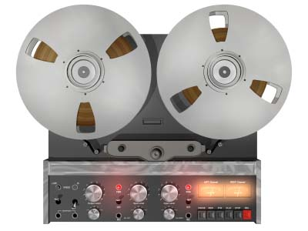
Flanging

Slide 2
Overview
Story
Background
How it works
Frequency Response
Interference
Sound and Pitch Modulation
Common parameters
Speed and Excursion
Depth Control
Inverted Mode
Flanger Feedback Control
Implementation

Slide 3
Story of the flanger
“They often liked to double-track their vocals, but it's quite a laborious process and they soon got fed up with it. So, after one particularly trying night-time session doing just that, I was driving home and suddenly had an idea."
Ken Townsend, Beatles Studio Technician
Artificial Double Tracking (ADT)
Recorded vocal track re-recorded onto second machine
Second machine has variable (oscillating) tape speed
Alternatively, change speed with finger on rim (flange) of wheel
Combine (mix) original and modulated signals
Irregularities mimic the natural variations in the human voice when overdubbed
“I knew he'd never understand it, so I said, 'Now listen, it's very simple. We take the original image and split it through a double vibrocated sploshing flange with double negative feedback...' He said, 'You're pulling my leg, aren't you?' I replied, 'Well, let's flange it again and see.' From that moment on, whenever he wanted ADT he would ask for his voice to be 'flanged,' or call out for 'Ken's flanger.' George Martin, Beatles Producer

Slide 4
Flanging introduction
First: 2 tape machines playing same tape
Outputs mixed equally
Flange of supply reel touched to make it play slower
Delay develops between machines
Then: flange released, flange of other machine touched
Delay gradually disappears, grows in opposite direction
Total delay kept below echo perception threshold
A few milliseconds in each direction
Repeat as desired, alternating flanges
Flange
y[n]

Slide 5
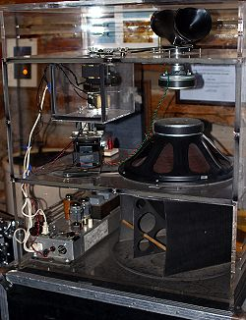

Flanging introduction
Characteristic sound referred to as whooshing
Like jet plane flying overhead
Rapid flanging introduces Doppler effect
Like Leslie speaker on electric organs
Creates equally-spaced notches in audio spectrum
Later: compare to phaser
Also based on notches
Spacing can be arbitrary
Phaser uses all-pass filters instead of delay
Leslie speaker
Creative Commons, Wikipedia
Drum loop dry, followed by same loop with flanging applied

Slide 6
Flanging: how it works
x[n]
y[n]
g
+
Delay M[n]
Mix signal with slightly delayed copy of itself
Length of delay constantly changing
Depth control
How much delayed signal added to original
Not an echo effect
Typical delays are 1-10ms
Human ear perceives echo starts at 50-70ms

Slide 7
Flanging: how it works
x[n]
y[n]
g
+
Delay M[n]
Feedforward comb filter
Input-output relation: y[n]=x[n]+gx[n- M(n)]
x[n] - input signal
y[n] - output signal
g - depth of flanging effect
M(n) - length of delay line at sample n
M(n) must vary smoothly over time
Interpolated (fractional) delay line allows noninteger M

Slide 8



Delay and interference
Consider two related signals:
Constructive interference:
for integer k
Destructive interference:
for integer k
Interference depends on delay with respect to frequency of the signal

Slide 9
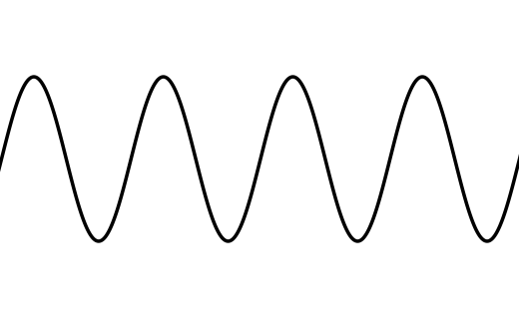
Delay and interference
(Usually undesired) destructive interference, known as comb filtering, is common in mixing
Multiple microphones to record single source
Mixing electric instrument direct signal with acoustic amplified signal
Parallel signal paths with different latency times
+
+
(2k+1)π/w
Constructive
Destructive

Slide 10
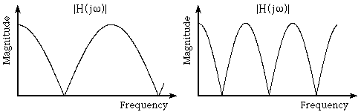

Frequency response
Delay & add has filtering effect on signal
Creates series of notches in frequency response
Eliminates periodically spaced set of frequencies
Other frequencies passed with amplitude change
Comb filter - notches resemble teeth on comb
Frequency response for two flangers with depth 1.
Which one has smaller delay, and why?

Slide 11
Frequency response of simple flanger
depth set to 1
delay values are 1, 2, 3 and 4 samples

Slide 12
Frequency response of a simple flanger
six sample delay and depth set to 1. The locations of the six peaks and six notches over the whole frequency range from 0 to 2π is shown
Six notches at π/6, 3π/6, 5π/6, 7π/6, 9π/6, 11π/6.
Peaks at 0, 2π/6, 4π/6, 6π/6, 8π/6, 10π/6.
Peaks
Notches

Slide 13





z-transform and delay theorem
Recall the z-transform
When we can find the frequency response
Normalised units, frequency ranges from 0 to 2π
Suppose we know the z-transform of a sequence
Then we have
and in general

Slide 14
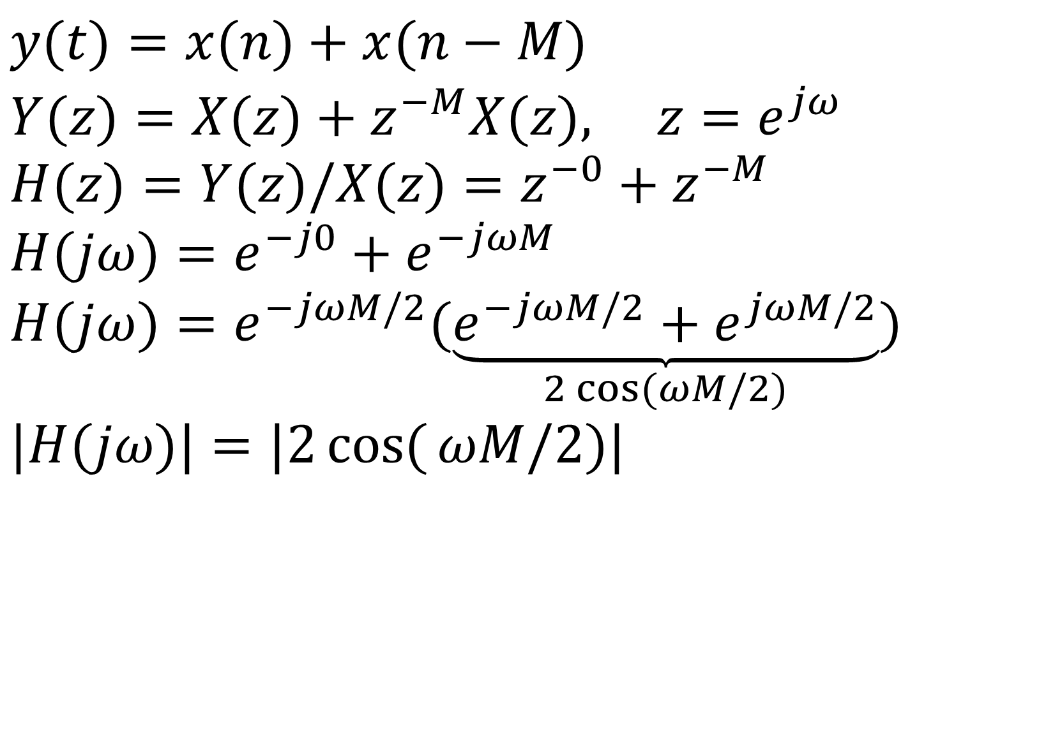
Flanger's Frequency Response
Delay
Equation:
Z-Transform:
Transfer Function:
Frequency
Response:
Amplitude
Response:
$$y(t)=x(n)+x(n−M) \\ Y(z)=X(z)+z^{−M}X(z), z=e^{jω} \\ H(z)=Y(z)/X(z)=z^{−0}+z^{−M} \\ H(jω)=e^{−j0}+e^{−jωM} \\ H(jω)=e^{−jωM/2}(\underset{2\cos{(}ωM/2)}{\underbrace{e^{−jωM/2}+e^{jωM/2}}}) \\ |H(jω)|=|2\cos{(}ωM/2)|$$

Slide 15





Frequency response
With depth control
Delay equation:
z-Transform:
Transfer function:
where
Frequency response:
Amplitude response:
Notice when g = 1, reduces to previous case
Notes:
Now consider including the gain term, g.

Slide 16
Amplitude response
Input-output relation for basic flanger y[n]=x[n]+gx[n- M(n)]
Transfer function H(z)=1+gz^{-M}
Amplitude response (gain versus frequency)
Peaks
When g > 0
M peaks in response
Here M = 6, 6 peaks
Peaks move slowly over time by changing M
Notches

Slide 17
Amplitude response
Peaks located at:
When depth g = 1:
Peaks maximally pronounced
M notches
Elimination of sound at single frequency or narrow freq. interval
Notches (or minima) located at:
g < 1 will produce less-than-complete attenuation
Peak / notch spacing at intervals of f_{s}/M Hz
fs is sample rate
Time variation of delay-line length M[n]
Flanging created by moving notches in spectrum
Notch motion essential for flanging effect
Static row of notches sounds like being in an acoustic tube
Isolated notch may be inaudible

Slide 18
Sound of a flanger
Characteristic sound results when these notches sweep up and down frequency axis over time
Sweeping action of notches achieved by continuously changing amount of delay used
As delay increases, notches go ...
Lower in the spectrum
Delay change set by low frequency oscillator (LFO)
For example, sine wave at < 5 Hz
Flanging.mov

Slide 19
Pitch modulation
Changing M(n) over time
What does this mean in practice?
Read faster or slower from delayed signal
dM/dt (or M[n] - M[n-1]) indicates difference in playback speed of delayed signal
Classic analogue tape example
Pitch changes as tape speeds up or slows down
Only delayed copy has pitch change
Mixed with original signal
Perceived pitch warbles

Slide 20
Depth control g
Determines how deep notches go
How pronounced the effect is
When depth is 0
frequency response is flat
No flanging
Increase depth→ notches appear and extend downward
When depth=1
notches extend down to 0
Peaks maximally pronounced
Even if notches<<1, they have audible effect
In multieffects units, g may only be controllable in mixer section, not flanging processor itself

Slide 21
Delay parameter
Minimum delay used on copy of signal
Determines how high the first notch will go
Increasing delay drops the first notch downward
If minimum delay = 0 ...
Notches sweep to uppermost frequency range, momentarily disappear
drum loop flanged with a delay of 1ms, and then 4 ms. Listen to notches sweep downward, then upward before returning to initial location.

Slide 22
Sweep width
Range of delay times (min to max delay)
Width (amplitude) of LFO
Sweep width is maximum additional delay
In addition to delay parameter (determines minimum)
Maximum delay = delay parameter + sweep width
Determines how low the first notch will go
Small width keeps variance in delay time small
Large width causes notches to sweep larger area
Sometimes called “sweep depth”
Not to be confused with depth g!
The maximum delay is the sum of the delay and sweep width parameters. The delay changes over time according to the sweep rate
Total
delay
Sweep
Width
(LFO amplitude)
LFO Period
Delay
parameter
Time

Slide 23
Sweep width
Increased width → increased pitch modulation
Why?
dM/dt will grow
Flanger needs to read faster and slower to change delay in same amount of time
Using sweep parameters:
Set delay to determine high frequency of sweep
Delay changes both upper and lower points of first notch
Adjust width to determine low frequency of sweep
Width only changes lower limit
plucked electric guitar string, first flanged with depth of 2 ms, then with 6 ms
Latter varies more in pitch

Slide 24
LFO settings
Delay M(n) modulated by low-frequency oscillator (LFO)
Waveform usually triangular, sinusoidal, or exponential
Exponential = triangle on log-frequency scale
For sinusoidal case: M[n]=M₀(1+Asin(2πfnT))
f - speed (or rate) of flanger in cycles per second
A - excursion or sweep (maximum delay swing)
M0 - average delay length (controls notch density)
Either A or M0 often not user-controllable
T - sampling period
Triangular LFO common in most flangers

Slide 25

LFO settings
Speed control
How many times per second notches oscillate
Also affects amount of pitch modulation (why?)
Derivative of sin term above:
Delay has to travel the same distance in less time

Slide 26
Feedback / regeneration
Take portion of flanger output, feed back to input
Regeneration control sets level of feedback
Feedback comb filter in addition to previous feedforward comb filter
Add or subtract feedback
Feedback usually in small amounts
Large feedback creates intense or “metallic” sound
Too large and it becomes unstable
Sound example: flanging with heavy feedback on strummed chord
g_{FB}
LFO
x[n]
y[n]
+
Delay M(n)
g_{FF}
+

Slide 27
Impulse responses for comb filter with 5 samples delay
gain g= 0.8 and no feedback
g_{FF}= 0.8 and g_{FB}= 0.5

Slide 28
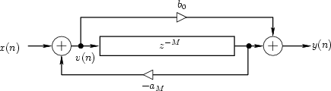
Feedback / regeneration
As feedback goes to 1, can become unstable
Just as in other feedback delay cases
Result: overflow or clipping
Control options
Add or subtract feedback signal
Feedback from any subset of allpass sections
Usually in small amounts
Combined feedback/feedforward comb filter

Slide 29
Flanger inverted mode
Different type of maximum depth obtained for g = -1
Peaks and notches trade places relative to g = 1
First notch at DC (f = 0)
Results in weak bass response
Unless minimum delay M >> 0
Depth control g usually constrained to [0, 1] interval
Sign inversion controlled with separate switch
Sounds high-pass filtered relative to g > 0
As M shrinks (and notch spacing grows):
Amplitude response approaches first-order difference
y[n]=x[n]-x[n-1]
Approximates (continuous) differentiator
Behaviour of ideal differentiator:
Eliminates DC
Progressive high-frequency boost (6dB/octave)
Amplitude response is |H(ω)|=|ω|

Slide 30
Digital implementation
Use delay lines (generally circular buffers)
Contiguous block of memory to store samples
Continuously read and write this space
Changing delay creates challenges
Samples are one sampling period apart
Delay line has to be an integer value
Solution: interpolation (fractional delay)
Estimate value between 2 samples
Zeroeth order: choose closest point to read from
Zipper noise: clicking in output as delay length changes
Linear interpolation: read value from line between points
Okay but still noisy
Cubic interpolation
Better, but computationally expensive

Slide 31
Notch spacing issues
Only uniformly spaced notches
non-ideal because:
Ear uses logarithmic frequency scale
Flanger notches spaced linearly
Exponentially spaced notches sound more perceptually uniform
Uniform peaks/notches impose discernible resonant pitch
Impression of being inside resonant tube

Slide 32
Disappearing instruments
If instrument harmonics land on notches
instrument may be eliminated from output
Exact alignment unlikely, but...
Loudness can be modulated as notches move through spectrum
Flanging best used with percussive, noisy or inharmonic sounds
Works well with drums
For harmonic sounds, need non-uniform notches
Flanging often used on entire mix, rather than specific instrument within mix

Slide 33


Stereo flangers
2 monophonic flangers in quadrature phase
Same depth, width, delay, etc.
LFO in each monophonic flanger differs in phase by 90 degrees (1/4 wavelength)
Creates ‘wider’ sound
Sound arriving at each ear is different
Sound examples
Dry, then monophonic flanger
Then stereo flanger

Slide 34
Flanger with feedback code (1)
// Variables used in this example whose values are set externally:
int numSamples; // Indicates how many audio samples to process
float *channelData; // Array of audio samples, length numSamples
float *delayData; // Our own circular delay buffer of audio samples
int delayBufLength; // Length of our delay buffer in samples
int dpw; // Write pointer into the delay buffer
float ph; // Current phase of the LFO, always between 0-1
float inverseSampleRate; // 1/f_s, where f_s is sampling frequency
// User-adjustable effect parameters:
float frequency_; // Frequency of the low-frequency oscillator
float sweepWidth_; // Width of the LFO in samples
float depth_; // Amount of delayed signal mixed with original (0-1)
float feedback_; // Amount of feedback on the delay (>= 0, < 1)

Slide 35
Flanger with feedback code (2)
for (int i = 0; i < numSamples; ++i) {
float in = channelData[i], interpolatedSample = 0.0;
float currentDelay=sweepWidth_*f*(1+sinf(2*M_PI*ph))/2; //Read to write pointer position
//Subtract 3 samples to delay pointer to ensure enough written samples to interpolate with
dpr = fmodf((dpw – (currentDelay * getSampleRate()) + delayBufLength – 3, delayBufLength);
// Linear interpolation to read fractional index into buffer.
// Find fraction by which read pointer sits between 2 samples, use to adjust weights of samples
float fraction = dpr - floorf(dpr);
int previousSample = (int)floorf(dpr);
int nextSample = (previousSample + 1) % delayBufLength;
interpolatedSample = fraction*delayData[nextSample] + (1.0f-fraction)*delayData[previousSample];
// Store current information in delay buffer. With feedback, what we read is included in what
// gets stored in buffer, otherwise it's just a simple delay line of the input signal.
delayData[dpw] = in + (interpolatedSample * feedback_);
//Write pointer moves at constant rate. Read pointer rate depends on LFO delay & sweep width.
if (++dpw >= delayBufLength) dpw = 0;
channelData[i] = in + depth_ * interpolatedSample; //Store output in buffer, replace input
ph += frequency_*inverseSampleRate; //Update LFO phase, keeping it in range 0-1
if(ph >= 1.0) ph -= 1.0;
}

